Slide 1

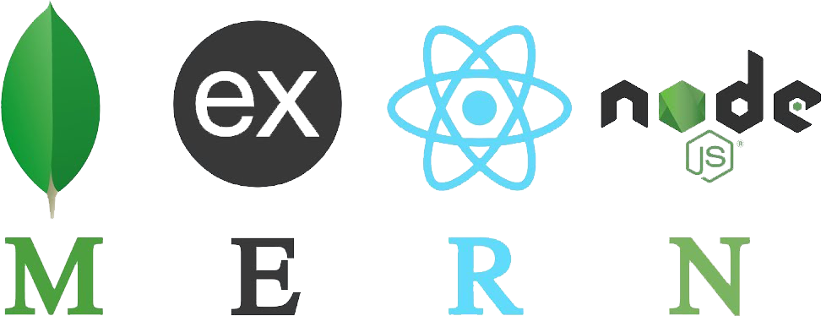
MERN Stack: A Full Stack Web App Dev from Front to Back (Session 2)
HANSEL G. DELOS SANTOS
MULTI-MEDIA SECTION
IT DEPARTMENT

Slide 2
Express App Setup

Slide 3
Review: Environment Setup and Back-End Development
Download and install nodeJS - https://nodejs.org/en/
Open CLI (cmd) to check the node version: c:\> node
Download and install VSCode - https://code.visualstudio.com/
Open VSCode and create a folder MERN-Project
Create a subfolder backend
Create a new empty file server.js then save
Open the terminal in VSCode and go to server folder: cd backend
Run npm (node package management) in the terminal: npm init –y (extract json dependencies)
Run npm install express in the terminal
Write the code in server.js then save all

Slide 4
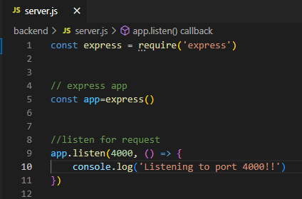
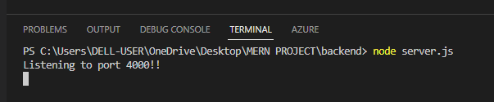
Review: Write the code in server.js
Run terminal in VSCode: node server.js
Control + C to terminate the running web server

Slide 5
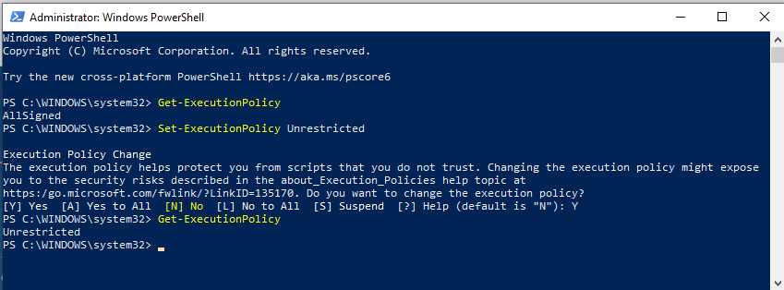
Install nodemon – node utility
Download and install nodemon from the VSCode Terminal –
npm install –g nodemon
If installation persist (windows). Workaround Open PowerShell as administrator
If installation persist in (Mac). Workaround: sudo npm install –g nodemon

Slide 6
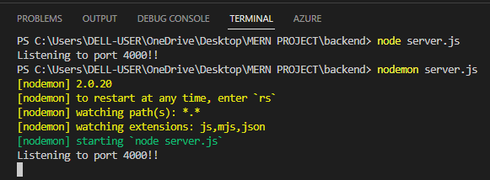
Running nodemon
Simple monitor script for use during development of a Node.js app.
From the VSCode Terminal run: nodemon server.js
Try to change the console.log(‘Server is running in PORT 4000’) then save all
Notice the server log from the terminal: real-time updates

Slide 7
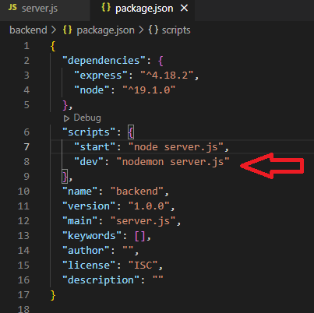
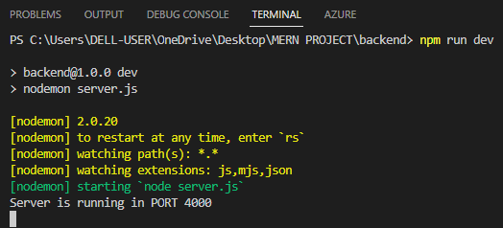
Debug the package.json file
Add the parameter
,“dev”: “nodemon server.js” from the scripts then save all
Then run from the vscode terminal:
npm run dev

Slide 8
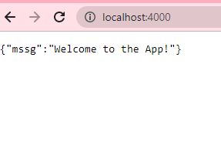
Cont. Route Handler (get)
These routing methods specify a callback function (sometimes called “handler functions”) called when the application receives a request to the specified route
// routes in server.js
app.get('/', (req,res) => {
res.json({mssg: "Welcome to the App!"})
})

Slide 9
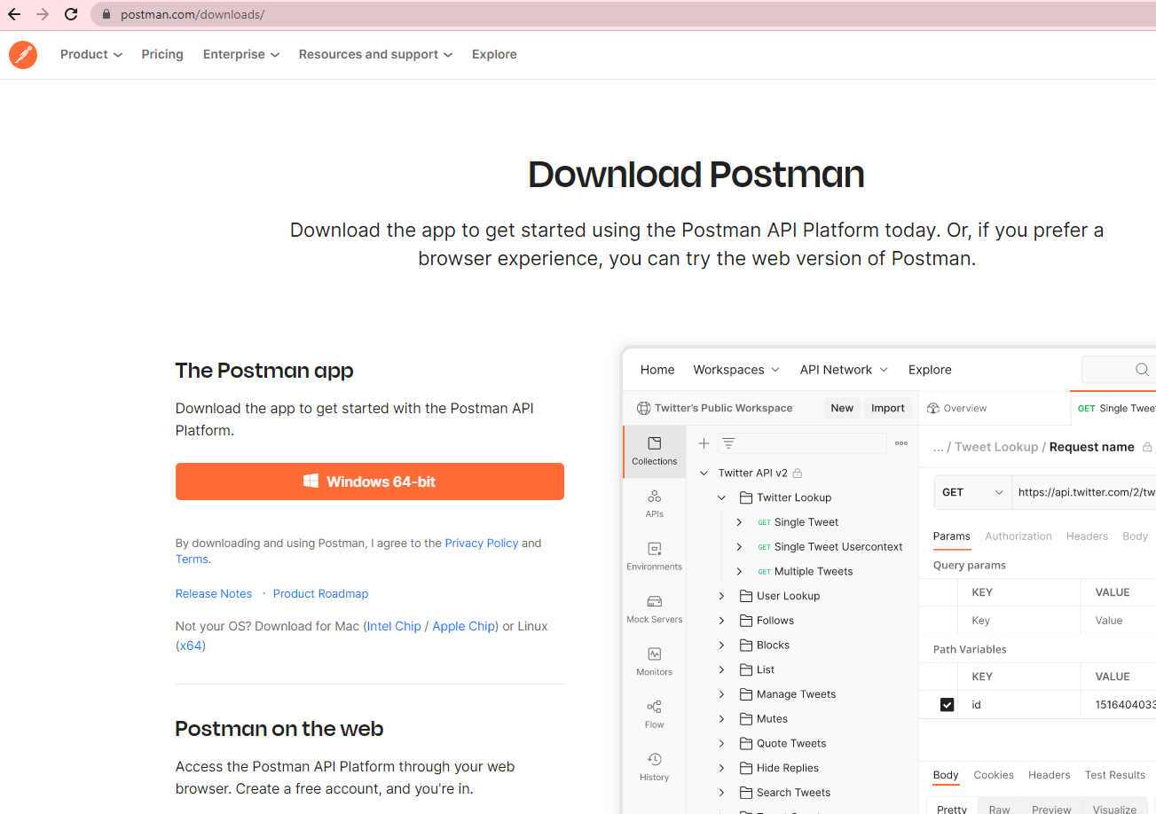
Using The Postman App
What is Postman?
Postman is an API platform for building and using APIs. Postman simplifies each step of the API lifecycle and streamlines collaboration so you can create better APIs—faster.
Download postman app
https://www.postman.com/downloads/
Install and Sign-in (current gmail)

Slide 10
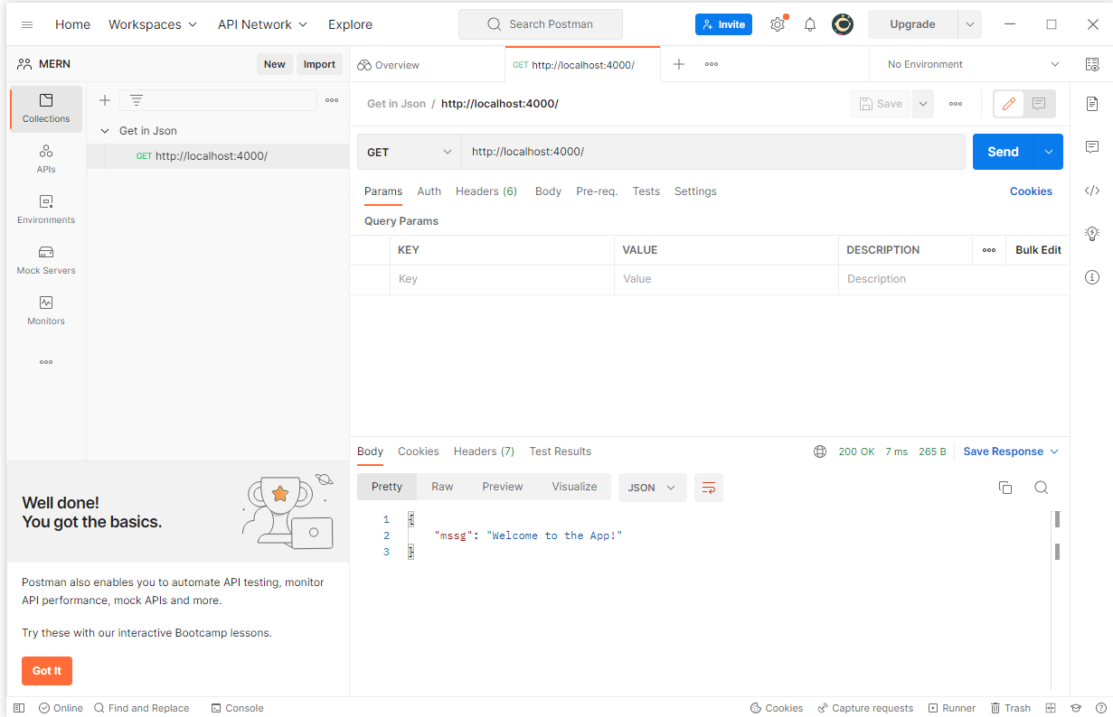
Using The Postman App
Create new workspace in Postman
Run the server.js in vscode terminal: nodemon server.js
Select GET method then paste the URL localhost:4000 then send
You can also save it from postman app

Slide 11
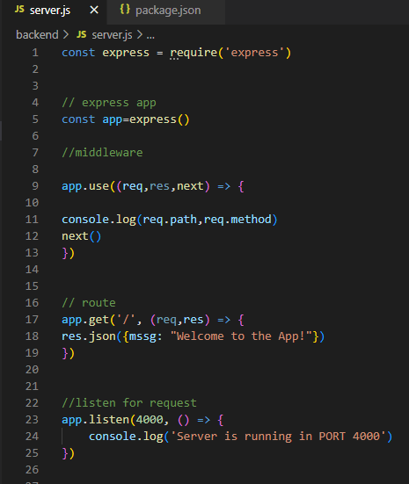
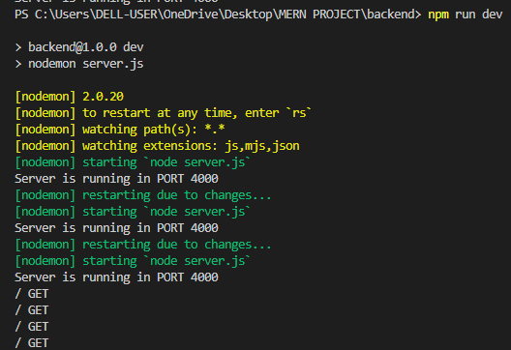
Creating a middleware in server.js
The middleware in node. js is a function that will have all the access for requesting an object, responding to an object, and moving to the next middleware function in the application request-response cycle.
//middleware app.use((req,res,next) => {
console.log(req.path,req.method)
next()
})

Slide 12
Express Router and API Routes

Slide 13
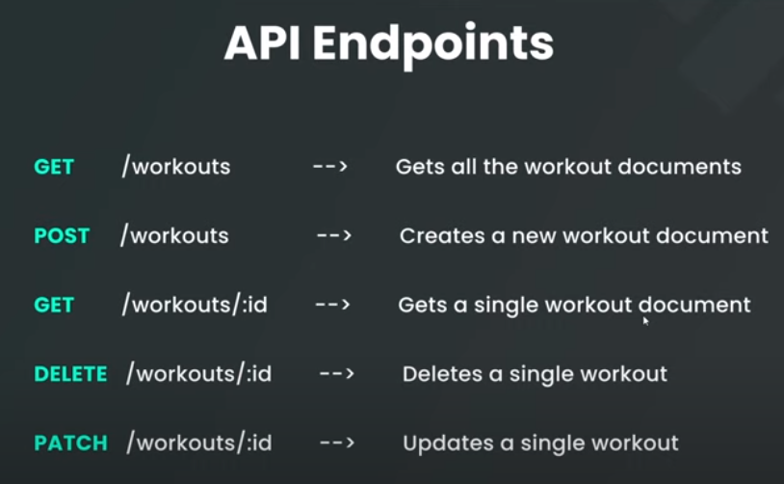
Creating API Endpoints
The API endpoint is a point at which an application program interface (API) connects with the software program. API's work by sending requests for information from a web application or web server and receiving a response.

Slide 14
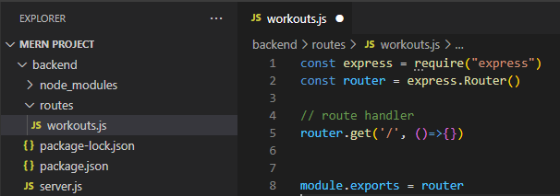
Creating API Endpoints
Inside the backend folder create a routes folder
Inside the routes folder create a new file workouts.js
From the server.js include the wourkouts.js
const WorkoutRoutes = require("./routes/workouts")
Modify the middleware/routes in server.js
//middleware
app.use(express.json())
// routes
app.use('/api/workouts',WorkoutRoutes)

Slide 15
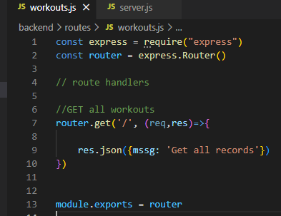
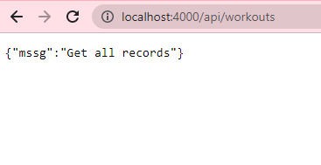
Creating GET Router – all records
Create get handler in workouts.js
Run from the browser

Slide 16
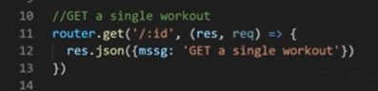
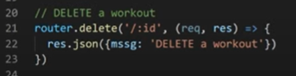
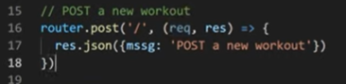
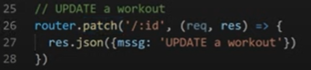
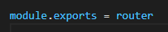
Creating Router API
Create GET single handler in workouts.js
Create DELETE single handler in workouts.js
Create POST handler in workouts.js
Create UPDATE single handler in workouts.js
Export the router module in workouts.js

Slide 17
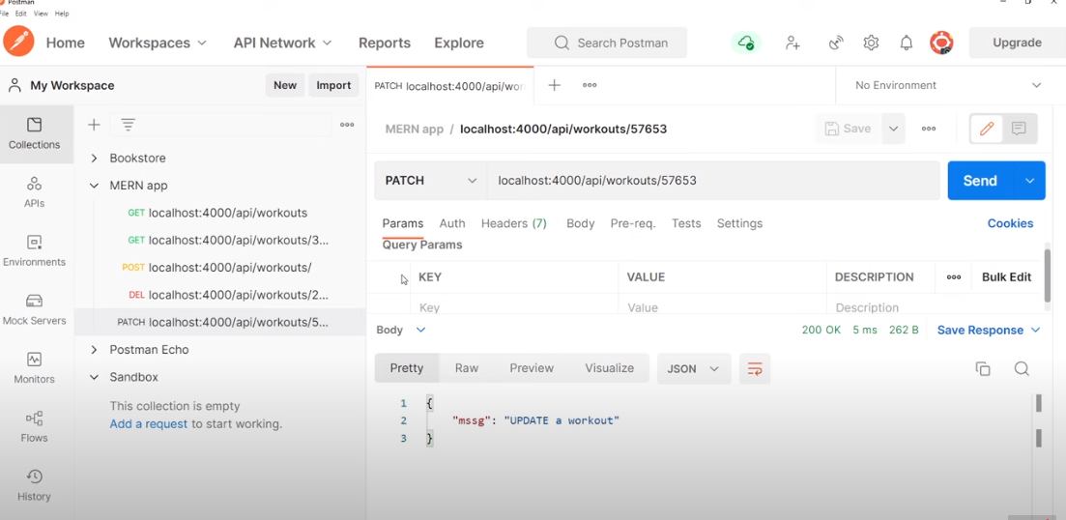
Testing the API using Postman App
Save the Get, Get Single, Post, Delete, and Update(Patch)

Slide 18
MongoDB Atlas and Mongoose

Slide 19
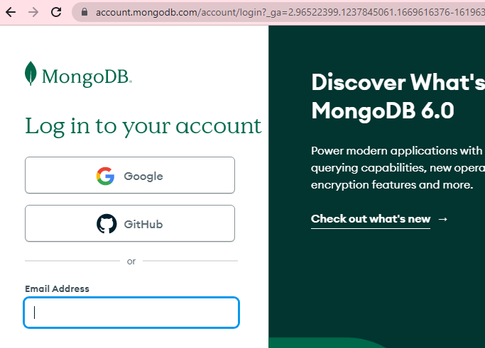
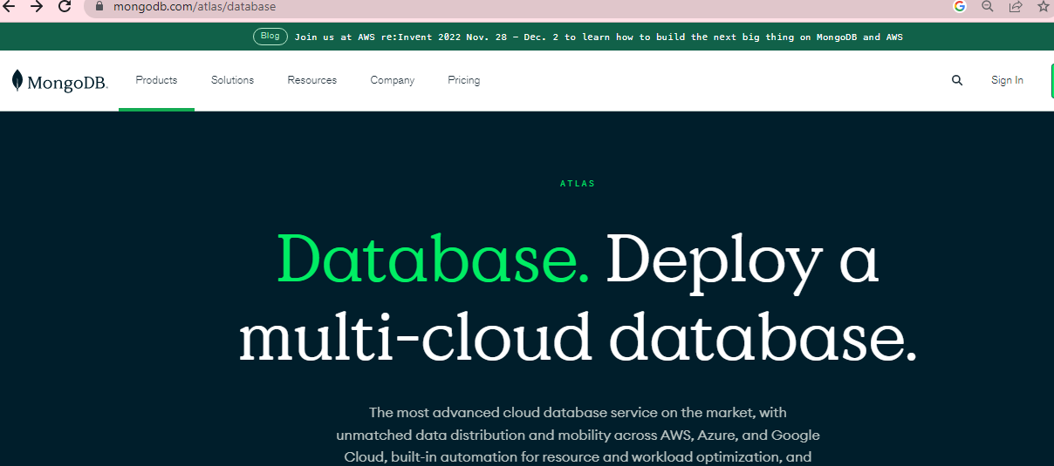
Setting-up MongoDB Atlas
Sign in: https://www.mongodb.com/atlas/database
Use your sct google credential

Slide 20
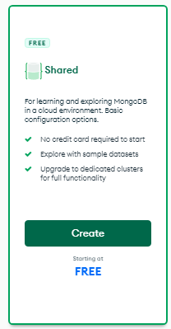
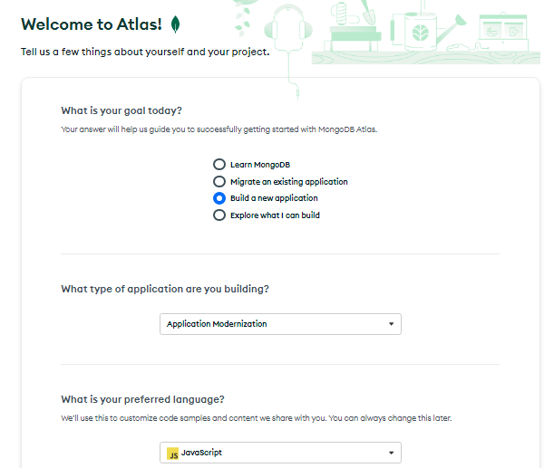
Cont…Setting-up MongoDB Atlas
Choose Share… FREE

Slide 21
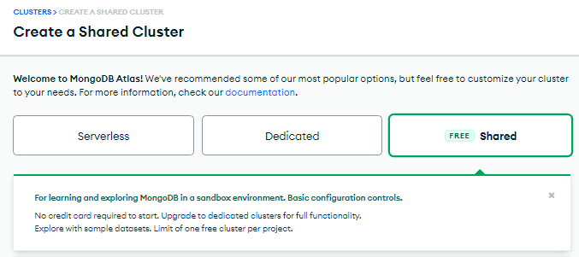
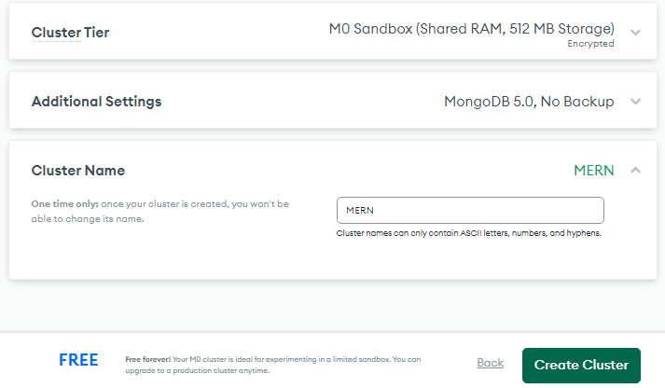
Create shared cluster
Write Cluster Name: MERN

Slide 22
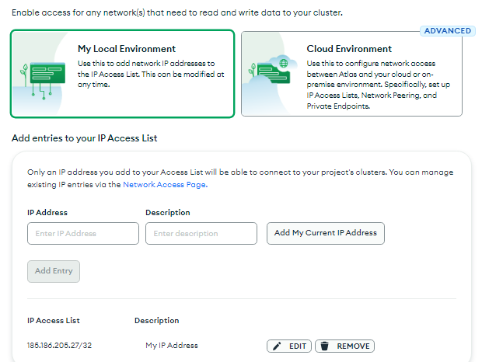
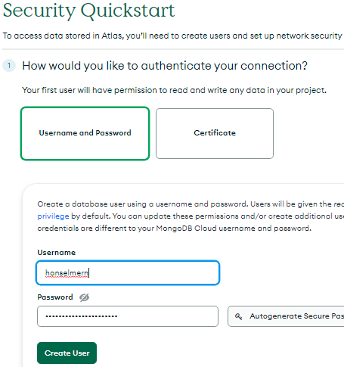
Create authentication to you connection
Create your username and password
Select Local Environment
Add My Current IP Address

Slide 23
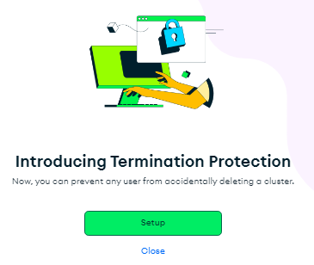
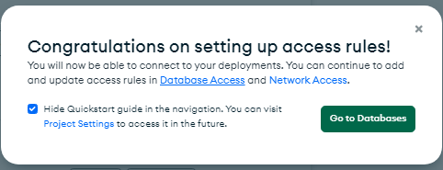
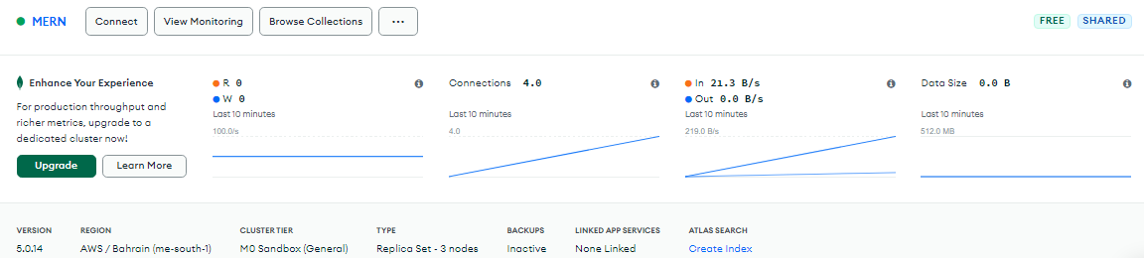
View the created cluster
Skip termination protection
Go to Database
Now you have created your database cluster in mongoDB Atlas.

Slide 24
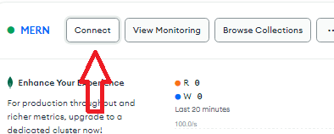
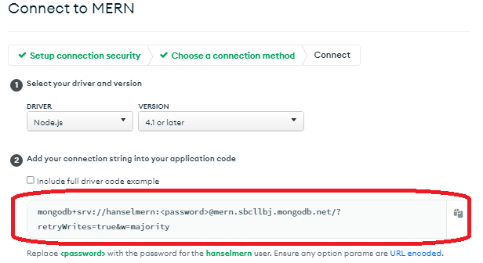
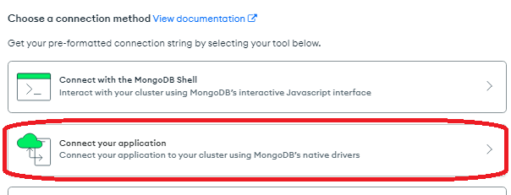
Connecting mongoDB Atlas to your Application
Go to Connect
Select Connect you Application
Copy the connection strings

Slide 25
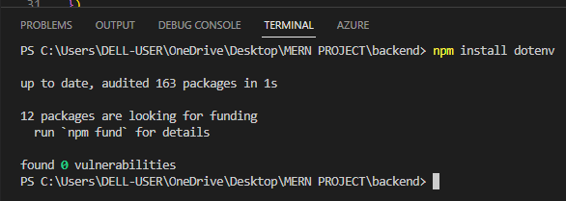
Install dotenv in vsCode
Open the vsCode terminal and run: npm install dotenv
Dotenv is a zero-dependency module that loads environment variables from a .env file into process.env

Slide 26
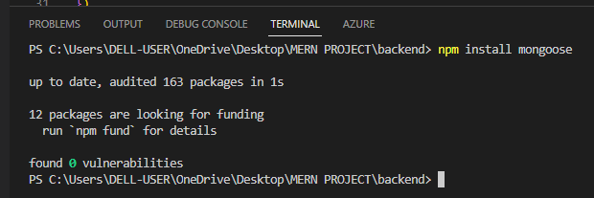
Install mongoose in vsCode
Open the vsCode terminal and run: npm install mongoose
Mongoose is a MongoDB object modeling tool designed to work in an asynchronous environment. Mongoose supports both promises and callbacks.

Slide 27
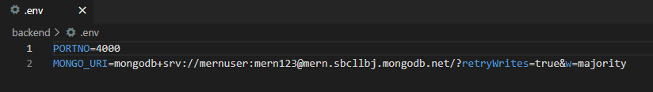
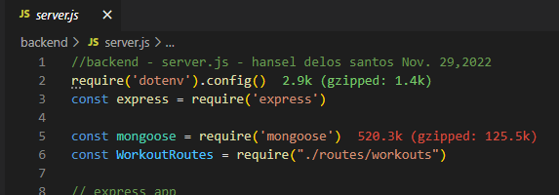
Create .env file in backend folder
Create .env file inside the backend folder
Add PORTNO variable and MONGO_URI then Pastes the string connection from MongoDB Atlas
Require both dotenv & mongoose in server.js

Slide 28
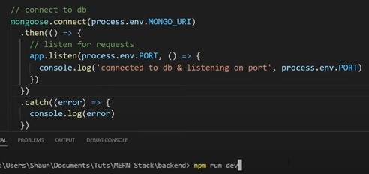
Modify the server.js
Create the DB connection, save the changes then run npm run dev from the terminal

Slide 29
Models and Schema

Slide 30
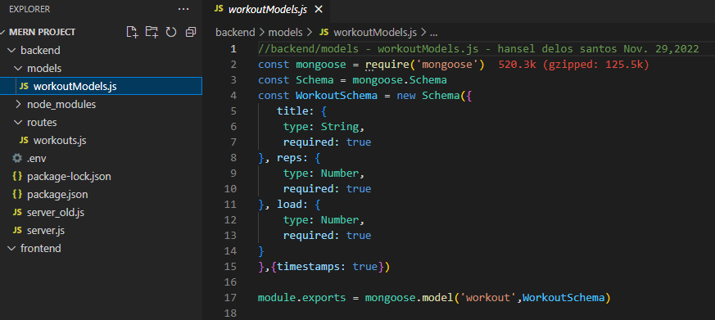
Create a workoutModels.js
Create a new folder models inside backend folder

Slide 31
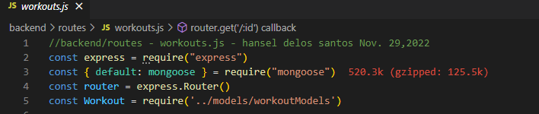
Modify workouts.js
Constant and require functions/methods

Slide 32
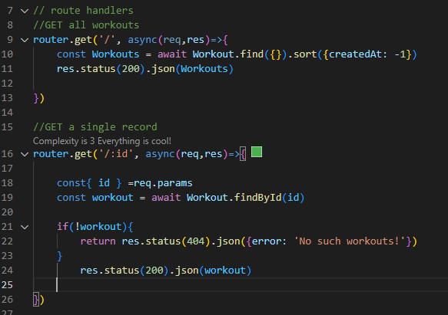
Modify workouts.js
GET all and Get Single Routes

Slide 33
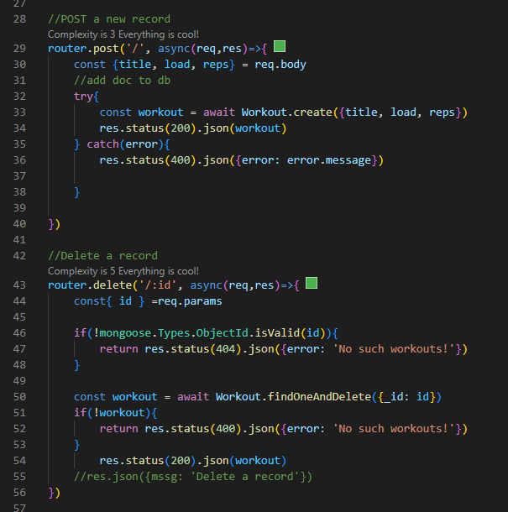
Modify workouts.js
POST and Delete Routes

Slide 34
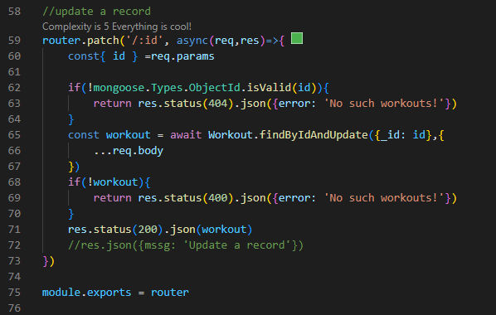
Modify workouts.js
UPDATE Route

Slide 35
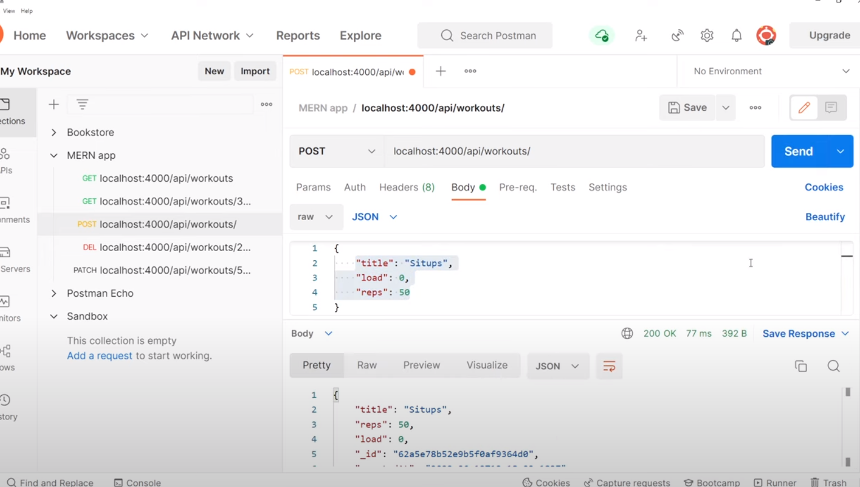
Run npm run dev from the terminal and test using Postman App

Slide 36
Making a React App (Session 3)

Slide 37
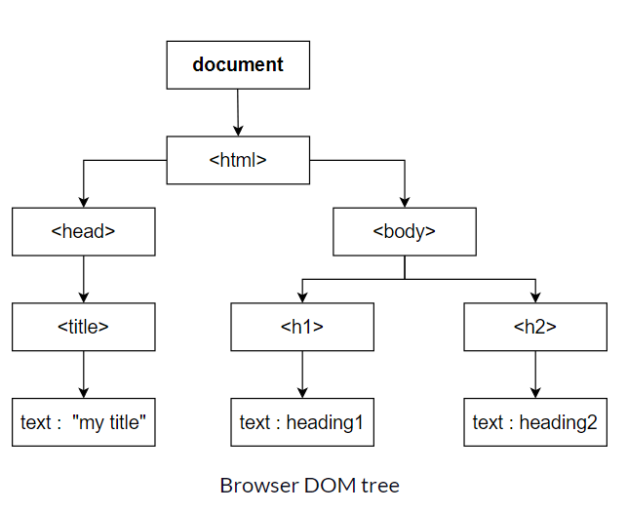
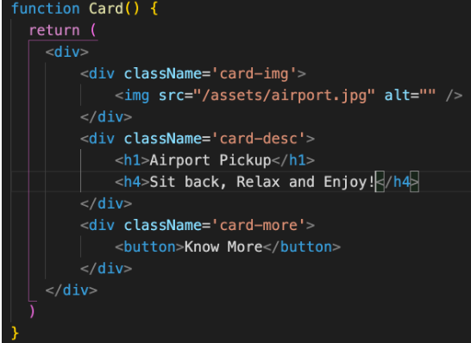
Fundamentals of React
What is a DOM?
The DOM (Document Object Model) represents the web page as a tree structure.
Any piece of HTML that we write is added as a node, to this tree.

Slide 38
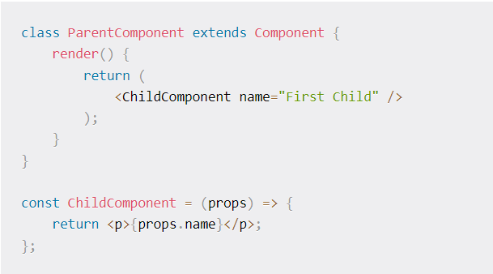
Fundamentals of React
What are props?
Props is short for properties and they are used to pass data between React components.
React’s data flow between components is uni-directional (from parent to child only).

Slide 39

Fundamentals of React
What is state?
React has another special built-in object called state, which allows components to create and manage their own data.
So unlike props, components cannot pass data with state, but they can create and manage it internally.

Slide 40


Fundamentals of React
What are hooks?
Hooks are the new feature introduced in the React 16.8 version.
It allows you to use state and other React features without writing a class. Hooks are the functions which "hook into" React state and lifecycle features from function components.
It does not work inside classes.

Slide 41


Creating a client folder
Create React App is a comfortable environment for learning React, and is the best way to start building a new single-page application in React.
Run npx create-react-app client from the vscode terminal (outside the server folder)
Open package.json file to check the parameter to run the app
Then run npm start from the vscode terminal (client folder)

Slide 42



Cleaning-up the client directory that only needed and debug the index.js and App.js files

Slide 43
Install the react package DOM
The react-router-dom package contains bindings for using React Router in the web application
From the client directory
Run npm install react-router-dom from the vscode terminal

Slide 44
-Creating/Fetching Data -Modifying Form -Deleting/Updating Data -Handling Error Response
Advanced Sessions-CRUD

Slide 45

Complete MERN-Project

Slide 46

Complete MERN-Project – source codes
Do check it out my github address
https://github.com/hansperm/workouts.git

Slide 47

Complete MERN-Project – source codes (Files Directories)

Slide 48
References:
https://www.w3schools.com/whatis/whatis_fullstack.asp
https://www.mongodb.com/
https://reactjs.org/tutorial/tutorial.html
https://nodejs.org/en/
https://expressjs.com/
https://code.visualstudio.com/
https://github.com/hansperm/workouts

